Slide 1

Chapter
5
Elasticity and
Its Application
Notes:
The elasticity chapter in most principles textbooks is fairly technical and is not always students’ favorite. This PowerPoint chapter contains several special features designed to engage and motivate students to learn this important material.
First, we consider a scenario in which students face a business decision—whether to raise the price of a service they sell (maintaining social media accounts for several businesses). This scenario is used to illustrate how raising prices affects the number of units sold and the amount of revenue received, which students immediately recognize as critical to the business decision.
Second, instead of merely listing the determinants of elasticity, students are asked to think about some concrete examples and deduce from each one a lesson about the determinants of elasticity.
Third, instead of putting the applications at the end of the chapter (as in the textbook), this PowerPoint includes one of them immediately after the section on price elasticity of demand. This helps break up what would otherwise be a long stretch of theory.
Please be assured that this PowerPoint presentation is, nonetheless, very consistent with the textbook’s approach.

Slide 2
IN THIS CHAPTER
What is elasticity?
What kinds of issues can elasticity help us understand?
What is the price elasticity of demand? How is it related to the demand curve? How is it related to revenue and expenditure?
What are the income and cross-price elasticities of demand?
What is the price elasticity of supply? How is it related to the supply curve?
Notes:
Here are the main sections in this chapter:
The Elasticity of Demand
The Elasticity of Supply
Three Applications of Supply, Demand, and Elasticity
Conclusion

Slide 3
Our Scenario
You maintain the social media accounts for local businesses. You charge P = $2,000 per business, and currently maintain the social media accounts for Q = 12 businesses per year.
Your costs are rising (including the opportunity cost of your time). You consider raising the price to $2,500.
The law of demand: if you raise your price, you will not have as many accounts to maintain.
How many fewer accounts?
How much will your revenue fall, or might it increase?
Notes:
We will follow this scenario throughout the first section of this chapter (the section on price elasticity of demand) to illustrate and prompt several important concepts, such as the impact of price changes on sales and revenue.

Slide 4
The Elasticity of Demand
Elasticity
Measure of how much buyers and seller respond to changes in market conditions
Measure of the responsiveness of Q^{d} or Q^{s} to a change in one of its determinants
Price elasticity of demand
How much the quantity demanded of a good responds to a change in its price
Loosely speaking, it measures the price-sensitivity of buyers’ demand
Notes:
Here, Q^{d} and Q^{s} are short for quantity demanded and quantity supplied, as in the PowerPoint for Chapter 4.
Price elasticity of demand for social media accounts measures how much demand for the social media accounts you maintain will fall if you raise your price. After all, the law of demand states an increase in price will lead to a decrease in the quantity demanded. The questions elasticity answers is ‘by how much?’
The textbook moves on to the determinants of the price elasticity of demand and then to formulas and calculating them. We’re tackling the formulas and calculations first, then the determinants and types of elasticities, hoping to reinforce the understanding of the formulas through lots of practice.

Slide 5

The Price Elasticity of Demand
Price elasticity of demand is
Along a D curve, P and Q move in opposite directions, which would make price elasticity negative.
We will drop the minus sign and report all price elasticities as positive numbers (absolute values).
P
$$=\frac{\begin{matrix}percentage & change & in & Q^{d}\end{matrix}}{\begin{matrix}percentage & change & in & P\end{matrix}} \\ =\frac{15\%}{10\%}=1.5$$
P rises by 10%
P₂
P₁
D
Q
Q₂
Q₁
Q falls by 15%
Notes:
It might be worth explaining to your students that “P and Q move in opposite directions,” derived from the law of demand, means that the percentage change in Q and the percentage change in P will have opposite signs, thus implying a negative price elasticity. In this example, “P rises by 10%” means “positive 10%,” while “Q falls by 15%” means “negative 15%” so the elasticity of demand is –15/10 = –1.5 (negative 1.5)
To be consistent with the text, the last statement says that we will report all price elasticities as positive numbers. It might be slightly more accurate to say that we will report all elasticities as non-negative numbers: we want to allow for the (admittedly rare) case of zero elasticity.
If the example gives us the percentage change in quantity and the percentage change in price, students just plug them in and calculate the elasticity. As we will see on the next slides, the situation becomes a bit more complicated if we know the quantities and prices, and students have to calculate the percentage changes. (instead of using the usual (new – old)/old, we’ll have to use the mid-point formula to calculate percentage changes).

Slide 6
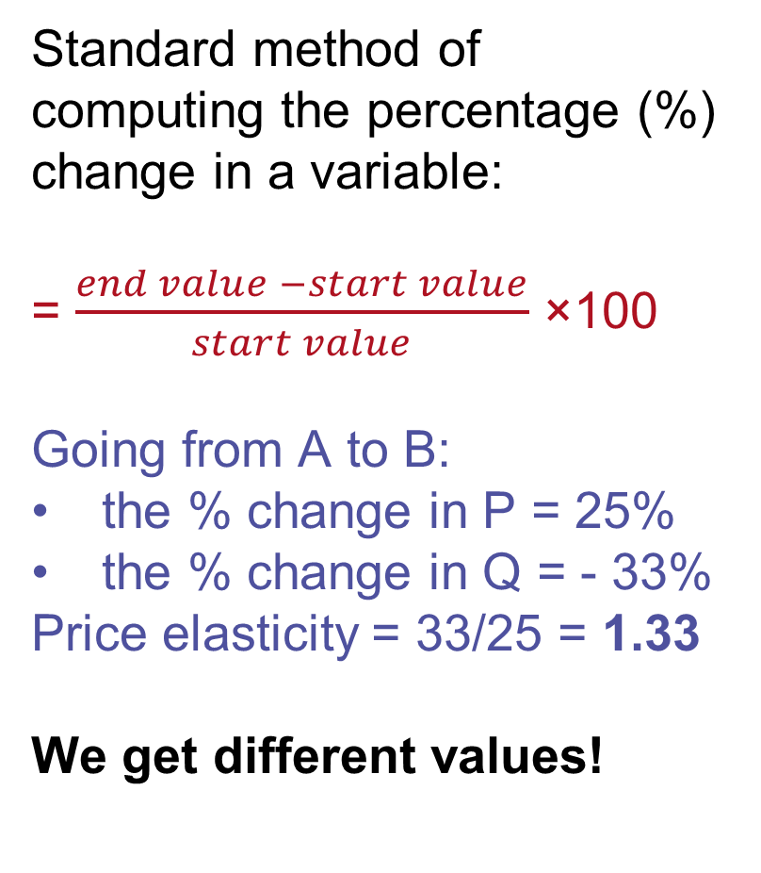
Calculating Percentage Changes
Demand for maintaining social media accounts
Standard method of computing the percentage (%) change in a variable:
= $\frac{end value −start value}{start value}$ ×100
Going from A to B:
the % change in P = 25%
the % change in Q = - 33%
Price elasticity = 33/25 = 1.33
We get different values!
P
B
$2500
A
$2000
D
Q
8
12
Going from B to A:
% change in P = - 20%
% change in Q = 50%
Price elasticity =50/20 = 2.5
Notes:
Problem: The standard method gives different answers depending on where you start. This example is used to show that we SHOULD NOT use this standard method when calculating percentage changes in a variable.
It’s worth it taking the time to help students through the calculations, if even just to show them how easy it is to make mistakes.
Going from A to B: start value is at point A, end value is at point B.
Percentage change in price = 100 * (P_{B} – P_{A} )/ P_{A} = 100 * ($2,500 – $2,000 )/ $2,000 = 100* $500 / $2,000 = 25%
And Percentage change in quantity = 100 * (Q_{B} – Q_{A} )/ Q_{A} = 100 * (8 – 12 )/ 12 = 100 * (- 4) / 12 = - 33.33% (we ignore the minus sign)
Calculating Price elasticity of demand = percentage change in Q / percentage change in P = 33.33% / 25% = 1.33
Going from point B to A: start value is at point B, end value is at point A.
Percentage change in price = 100 * (P_{A} – P_{B} )/ P_{B} = 100 * ($2,000 – $2,500 )/ $2,500 = 100* (- $500) / $2,500 = - 20% (we ignore the minus sign)
And Percentage change in quantity = 100 * (Q_{A} – Q_{B} )/ Q_{B} = 100 * (12 – 8 )/ 8 = 100 * 4 / 8 = 50%
Calculating Price elasticity of demand = percentage change in Q / percentage change in P = 50% / 20% = 2.5

Slide 7
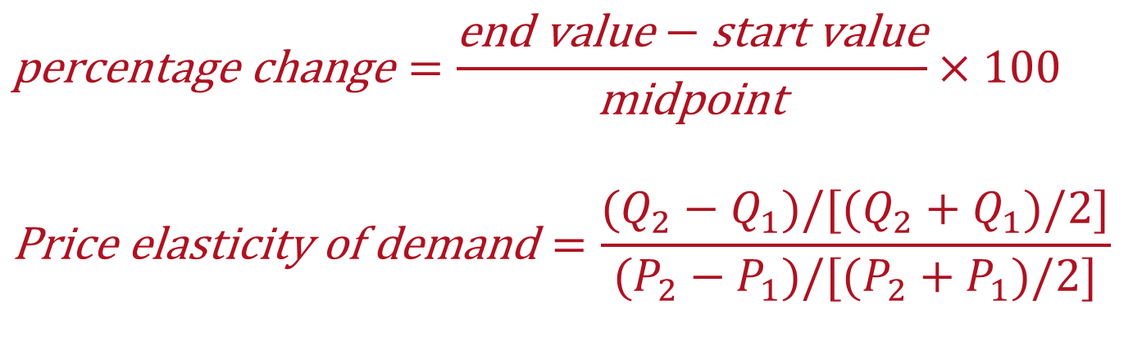
The Price Elasticity of Demand
Midpoint method
The midpoint is the number halfway between the start and end values
The average of those values
$$\text{percentage} \text{change}=\frac{\text{end} \text{value}−\text{start} \text{value}}{\text{midpoint}}×100$$
$$\text{Price} \text{elasticity} \text{of} \text{demand}=\frac{(Q_{2}−Q_{1})/[(Q_{2}+Q_{1})/2]}{(P_{2}−P_{1})/[(P_{2}+P_{1})/2]}$$
Notes:
We solved the issue encountered when we used the standard method by switching to the MIDPOINT FORMULA of calculating percentage changes in a variable (instead of dividing by the difference, we divide by the average or the midpoint). It doesn’t matter which value you use as the start and which as the end—you get the same answer either way!
Q1 is the start value and Q2 is the end value for the quantity. P1 is the start value and P2 is the end value for the price.

Slide 8
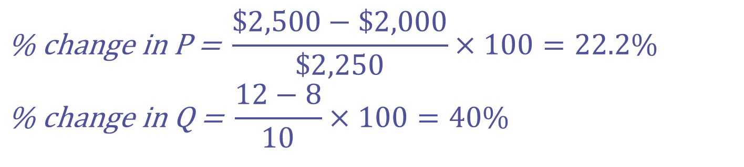
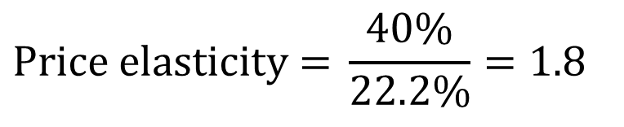
Our Scenario: Calculating Percentage Changes
Demand for maintaining social media accounts
Using the midpoint method of computing percentage changes:
P
B
$2500
A
$2000
$$\text{Price} \text{elasticity}\text{ = }\frac{40\%}{22.2\%}=1.8$$
D
Q
8
12
$$\text{\% }\text{change} \text{in} \text{P}\text{ = }\frac{\$2,500−\$2,000}{\$2,250}×100=22.2\% \\ \text{\% }\text{change} \text{in} \text{Q}\text{ = }\frac{12−8}{10}×100=40\%$$
Notes:
It doesn’t matter if we are going to calculate percentage changes from A to B or from B to A, we always get the same result. Problem solved!

Slide 9
Active Learning 1: Calculate an elasticity
Use the following information to calculate the price elasticity of demand for iPhones:
if P = $400, Q^{d} = 10,600
if P = $600, Q^{d} = 8,400
Use the midpoint method to calculate percentage change in price
Use the midpoint method to calculate percentage change in quantity
Calculate the price elasticity of demand
Notes:
Allow your students 5 minutes to work by themselves or in groups before asking for volunteers to share their answers.
This exercise leads students to review all they have learned about calculating the price elasticity of demand. Remind your students to write down the formulas for each calculation.

Slide 10
Active Learning 1: Answers
Using the midpoint method to calculate percentage changes:
% change in P =
[($600 - $400)/$500] ×100 = 40%
% change in Q^{d} =
[(8,400 – 10,600)/9,500] ×100 = - 23.16%
Price elasticity of demand =
= % change in Q^{d} / % change in P
= 23.16 / 40 = 0.58 (ignoring the minus sign)
Notes:
A common mistake your students will make is to calculate the price elasticity of demand as 40/23 because they first calculate the % change in P, then % change in Q and then they (think they remember the correct formula) slap % change in P over the % change in Q and get the elasticity wrong! Remind your students that writing down formulas will avoid these kind of mistakes.

Slide 11
Determinants of Price Elasticity of Demand
We look at a series of examples comparing two common goods.
In each example:
Suppose prices of both goods rise by 20%
Which good has the highest price elasticity of demand? Why?
What lesson we learn about the determinants of price elasticity of demand?
Notes:
In essence, the textbook says “Here are the determinants of elasticity. The first one is availability of close substitutes. Here’s an example….”
That’s great for a textbook. For teaching, I’ve found a different approach to be far more effective: having students deduce the general lessons from specific examples they can figure out using common sense. This is the approach on the next few slides.
Also, see notes on the next slide for a good suggestion.

Slide 12
EXAMPLE 1: Cheerios vs. Airfare
Prices of both of these goods rise by 20%. For which good does Q^{d} drop the most? Why?
Cheerios has many close substitutes, so buyers can easily switch if the price rises
Traveling by airplanes has no close substitutes, so a price increase would not affect demand very much
Price elasticity is higher when close substitutes are available.
Notes:
Suggestion: For each of these examples, display the slide title (which lists the two goods) and the first bullet point (which ask which good experiences the biggest drop in demand in response to a 20% price increase). Give your students a quiet minute to formulate their answers. Then, ask for volunteers.
Goods with close substitutes tend to have more elastic demand because it is easier for consumers to switch from those goods to others.

Slide 13
EXAMPLE 2: Mountain Dew vs. Soda (pop)
Prices of both of these goods rise by 20%. For which good does Q^{d} drop the most? Why?
For a narrowly defined good, Mountain Dew, there are many substitutes
There are fewer substitutes available for broadly defined goods (soda / pop)
Price elasticity is higher for narrowly defined goods than for broadly defined ones.
Notes:
You might need to clarify the nature of this thought experiment.
Here, we look at two alternate scenarios. In the first, the price of Mountain Dew (and no other soft fizzy drinks) rises by 20%, and we observe the percentage decrease in quantity of Mountain Dew demanded.
In the second scenario, the price of all soda (pop; all soft fizzy drinks) rises by 20%, and we observe the percentage decrease in demand for all soda.
Narrowly defined markets tend to have more elastic demand than broadly defined ones. That’s because it is easier to find close substitutes for narrowly defined goods.

Slide 14
EXAMPLE 3: Insulin vs. Rolex watches
Prices of both of these goods rise by 20%. For which good does Q^{d} drop the most? Why?
Insulin is a necessity to diabetics. A rise in price would cause little or no decrease in quantity demanded
A Rolex watch is a luxury. If the price rises, some people will forego it.
Price elasticity is higher for luxuries than for necessities.
Notes:
For a true necessity, a small price increase won’t diminish the amount you purchase by very much (necessities tend to have inelastic demands). Whether a good is a necessity or a luxury depends not on its intrinsic properties but on the buyer’s preferences.

Slide 15
EXAMPLE 4: Gasoline, Short Run vs. Long Run
The price of gasoline rises 20%. Does Q^{d} drop more in the short run or the long run? Why?
There’s not much people can do in the short run, other than ride the bus or carpool.
In the long run, people can buy smaller cars or live closer to work.
Price elasticity is higher in the long run.
Notes:
Demand tends to be more elastic over longer periods of time because consumers have time to adjust their purchasing habits.

Slide 16
The Variety of Demand Curves – 1
Demand is elastic
Price elasticity of demand > 1
Demand is inelastic
Price elasticity of demand < 1
Demand has unit elasticity
Price elasticity of demand = 1
Notes:
There are 5 of them: perfectly elastic, elastic, unit elastic, inelastic, and perfectly inelastic. They are listed on this slide and the next. Then, on the following 5 slides, each variety of demand curves gets its own graph and explanations.

Slide 17
The Variety of Demand Curves – 2
Demand is perfectly inelastic
Price elasticity of demand = 0
Demand curve is vertical
Demand is perfectly elastic
Price elasticity of demand = infinity
Demand curve is horizontal
The flatter the demand curve
The greater the price elasticity of demand

Slide 18
Perfectly Inelastic Demand
Price elasticity of demand
% change in Q
0%
=
=
= 0
% change in P
10%
P
D curve:
Vertical
Consumers’ price sensitivity:
None
Elasticity:
0
D
P₁
P₂
P falls by 10%
Q₁
Q
Q changes by 0%
Notes:
Remind your students that we are moving along a demand curve, so the only reason Q^{d} changes is because of a price change.
With a perfectly inelastic demand: Q doesn’t change, so the percentage change in Q equals zero, and thus elasticity equals zero.
It is hard to think of a good for which the price elasticity of demand is literally zero. Take insulin, for example. A sufficiently large price increase would probably reduce the quantity demanded for insulin a little, particularly among people with very low incomes and no health insurance.
However, if elasticity is very close to zero, then the demand curve is almost vertical. In such cases, the convenience of modeling demand as perfectly inelastic probably outweighs the cost of being slightly inaccurate.

Slide 19
Inelastic Demand
Price elasticity of demand
% change in Q
<10%
=
=
< 1
% change in P
10%
P
D curve
relatively steep
Consumers’ price sensitivity:
relatively low
Elasticity:
<1
P₁
P₂
D
P falls by 10%
Q₁
Q₂
Q
Q rises less than 10%
Notes:
An example: Student demand for textbooks that their professors have required for their courses.
Here, it’s clear that elasticity would be small, but not zero. At a high enough price, some students will not buy their books, but instead will share with a friend, or try to find them in the library, or just take copious notes in class.
Another example: Gasoline in the short run.

Slide 20
Unit Elastic Demand
Price elasticity of demand
% change in Q
10%
=
=
= 1
% change in P
10%
D curve
intermediate slope
Consumers’ price sensitivity:
intermediate
Elasticity:
=1
P
P₁
P₂
D
P falls by 10%
Q₁
Q₂
Q
Q rises by 10%
Notes:
This is the intermediate case: the demand curve is neither relatively steep nor relatively flat. Buyers are neither relatively price-sensitive nor relatively insensitive to price.
(This is also the case where price changes have no effect on revenue.)

Slide 21
Elastic Demand
Price elasticity of demand
% change in Q
>10%
=
=
> 1
% change in P
10%
P
D curve
relatively flat
Consumers’ price sensitivity:
relatively high
Elasticity:
>1
P₁
P₂
D
P falls by 10%
Q₁
Q₂
Q
Q rises more than 10%
Notes:
A good example here would be breakfast cereal, or nearly anything with many readily available substitutes.
An elastic demand curve is flatter than a unit elastic demand curve (which itself is flatter than an inelastic demand curve).

Slide 22
Perfectly Elastic Demand
Price elasticity of demand
% change in Q
any %
=
=
= infinity
% change in P
0%
P
D curve
horizontal
Consumers’ price sensitivity:
extreme
Elasticity:
infinity
D
P₂ =
P₁
P changes by 0%
Q₁
Q₂
Q
Q changes by any %
Notes:
“Extreme price sensitivity” means the tiniest price increase causes demand to fall to zero.
“Q changes by any %” – when the Q curve is horizontal, quantity cannot be determined from price. Consumers might demand Q₁ units one month, Q₂ units another month, and some other quantity later. Q can change by any amount, but P always “changes by 0%” (i.e., it doesn’t change).
If perfectly inelastic is one extreme, this case (perfectly elastic) is the other.
Here’s a good real-world example of a perfectly elastic demand curve, which foreshadows an upcoming chapter on firms in competitive markets. Suppose you run a small family farm in Iowa. Your main crop is wheat. The market demand curve in this market is downward-sloping, and the market demand and supply curves determine the price of wheat. There are lots of buyers and lots of sellers in this market. Suppose that price is $5/bushel.
Now consider the demand curve facing YOU, the individual wheat farmer. If you charge a price of $5, you can sell as much or as little as you want (so you will sell your entire production). If you charge a price even just a little higher than $5, demand for YOUR wheat will fall to zero: Buyers would not be willing to pay you more than $5 when they could get the same wheat elsewhere for $5. Similarly, if you drop your price below $5, then demand for YOUR wheat will become enormous (not literally infinite, but “almost infinite”): if other wheat farmers are charging $5 and you charge less, then EVERY buyer will want to buy wheat from you (but you still only sell what you produce).
Why is the demand curve facing an individual producer perfectly elastic? Recall that elasticity is greater when lots of close substitutes are available. In this case, you are selling a product that has many perfect substitutes: the wheat sold by every other farmer is a perfect substitute for the wheat you sell.

Slide 23
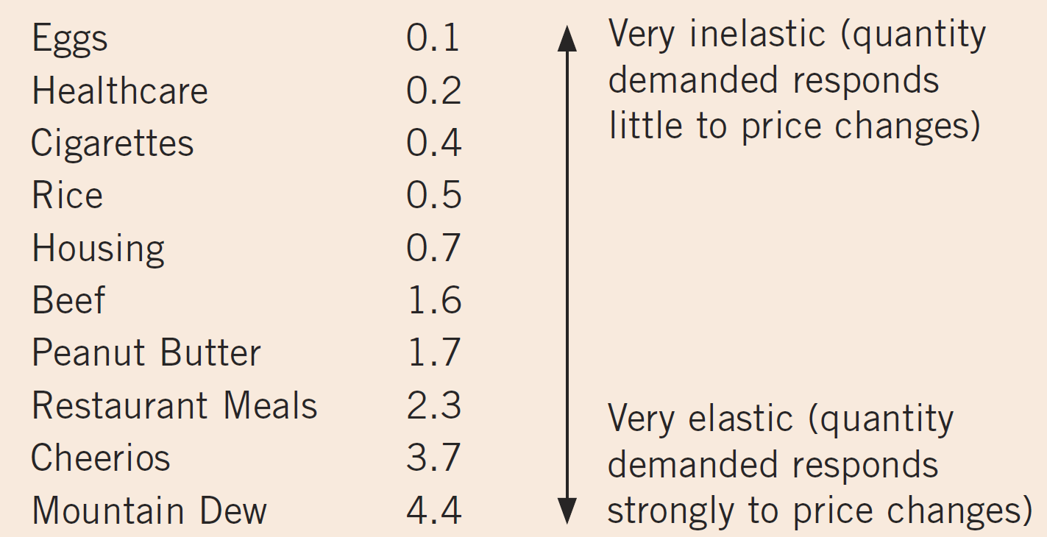
A Few Elasticities from the Real World
Notes:
This slide corresponds to an FYI box in the textbook. Economists collect market data and apply statistical techniques to estimate the price elasticity of demand. These are estimates, and different studies will report different estimates.

Slide 24
Elasticity Along a Linear Demand Curve
The slope of a linear demand curve is constant, but its elasticity is not.
P
200%
$30
E =
= 5.0
40%
67%
20
E =
= 1.0
67%
40%
10
E =
= 0.2
200%
$0
Q
0
20
40
60
Notes:
Figure 4 in the textbook does similar calculations to show that at points with a low price and high quantity, the demand curve is inelastic; at points with a high price and low quantity, the demand curve is elastic. So, the absolute value of the price elasticity of demand decreases as the price decreases (as we mode downward to the right along the D curve).
Due to space limitations, this slide uses “E” as an abbreviation for price elasticity of demand. The calculations shown on the slide use the midpoint method. It’s worth it to take the extra time to calculate the price elasticity of demand between the various points.
First, the price drops from $30 to $20, and the quantity demanded increases from 0 to 20.
% change in P = 100* difference / midpoint = 100 * ($20 - $30)/ [$20 + $30)/2] = 100 *(-$10) / $25 = -40% (ignoring the minus sign)
% change in Q = 100* difference / midpoint = 100 * (20-0)/ [20+0)/2] = 100 * 20 / 10 = 200%
E = % change in Q / % change in P = 200 / 40 = 5
Next, the price drops from $20 to $10, and the quantity demanded increases from 20 to 40.
% change in P = 100* difference / midpoint = 100 * ($10 - $20)/ [$10 + $20)/2] = 100 *(-$10) / $15 = -66.66% (ignoring the minus sign)
% change in Q = 100* difference / midpoint = 100 * (40-20)/ [40+20)/2] = 100 * 20 / 30 = 66.66%
E = % change in Q / % change in P = 67 / 67 = 1
And last, the price drops from $10 to $0, and the quantity demanded increases from 40 to 60.
% change in P = 100* difference / midpoint = 100 * ($0 - $10)/ [$0 + $10)/2] = 100 *(-$10) / $5 = -200% (ignoring the minus sign)
% change in Q = 100* difference / midpoint = 100 * (60-40)/ [60+40)/2] = 100 * 20 / 50 = 40%
E = % change in Q / % change in P = 40 / 200 = 0.2
As you move down a linear demand curve, the slope remains constant. You can verify this by calculating the slope between any two pairs of points on the line (rise over run).
However, the percentage changes between pairs of points vary, so the elasticity varies. The calculations shown on the slide confirm that elasticity falls as you move downward and rightward along a linear demand curve (as the price drops and the quantity demanded increases).
Note also that the most elastic portion of the demand curve is where buyers have relatively few units and a high willingness to pay for additional units. As buyers acquire more units and their willingness to pay for additional ones falls, so does the price elasticity of demand.
At points with a low price and high quantity, a linear demand curve is inelastic.
At points with a high price and low quantity, a linear demand curve is elastic.

Slide 25
Our Scenario: Total Revenue
Continuing our scenario, if you raise your price from $2,000 to $2,500, would your revenue rise or fall?
Total Revenue (TR) = P x Q
A price increase has two effects on revenue:
Higher revenue: because of the higher P
Lower revenue: you maintain fewer accounts (lower Q)
Which of these two effects is bigger?
It depends on the price elasticity of demand
Notes:
We return to our scenario. It’s not hard for students to imagine being in this position—running their own business and trying to decide whether to raise the price.
To most of your students, it should be clear that making the best possible decision would require information about the likely effects of the price increase on revenue. That is why elasticity is so helpful, as we will now see….

Slide 26
Our Scenario: Elastic Demand (E = 1.8)
Demand for maintaining social media accounts
Price elasticity of demand = 1.8
If P = $2,000,
Q = 12, then TR = $24,000
If P = $2,500,
Q = 8, then TR = $20,000
When D is elastic, a price increase causes revenue to fall.
increased revenue due to higher P
P
lost revenue due to lower Q
$2500
$2000
D
Q
8
12
Notes:
Point out to students that the area (outlined in blue) representing lost revenue due to lower Q is larger than the area (outlined in green) representing increased revenue due to higher P. Hence, the net effect is a fall in revenue.

Slide 27
Our Scenario: Inelastic Demand (E = 0.82)
Demand for maintaining social media accounts
Price elasticity of demand = 0.82
If P = $2,000,
Q = 12, then TR = $24,000
If P = $2,500,
Q = 10, then TR= $25,000
When D is inelastic, a price increase causes revenue to rise.
increased revenue due to higher P
P
lost revenue due to lower Q
$2500
$2000
D
Q
10
12
Notes:
Point out to students that the area representing lost revenue due to lower Q (outlined in blue) is smaller than the area representing increased revenue due to higher P (outlined in green). Hence, the net effect is an increase in revenue.
The knife-edge case, not shown here but perhaps worth mentioning in class, is a case of unit-elastic demand. In that case, an increase in price leaves revenue unchanged: the increase in revenue from higher P exactly offsets the lost revenue due to lower Q.

Slide 28
Price Elasticity and Total Revenue
For a price increase, if demand is elastic
TR decreases: the fall in Q is proportionately greater than the rise in P.
The extra revenue from selling units at a higher price is smaller than the decline in revenue from selling fewer units
For a price increase, if demand is inelastic
TR increases: the fall in Q is proportionately smaller than the rise in P.
The extra revenue from selling units at a higher price more than offsets the decline in revenue from selling fewer units
Notes:
For a price increase, if demand is elastic (E > 1) then % change Q / % change P > 1, so the % change in Q is greater than the % change in P. This results in TR decrease: the fall in revenue from lower Q > the increase in revenue from higher P.
For a price increase, if demand is inelastic (E < 1) then the % change in Q < the % change in P; TR increases: the fall in revenue from lower Q < the increase in revenue from higher P.
The general rules:
- When demand is inelastic ( E < 1), P and TR move in the same direction.
When demand is elastic (E > 1), P and TR move in opposite directions.
If demand is unit elastic ( E = 1), TR remains constant when the price changes.

Slide 29
Active Learning 2: Elasticity and total revenue
Pharmacies raise the price of insulin by 10%.
Does total expenditure on insulin rise or fall?
As a result of a fare war, the price of a luxury cruise falls 20%.
Does luxury cruise companies’ total revenue rise or fall?
Notes:
These problems, perhaps similar to those you might ask on an exam, are complex in that they test several skills at once: students must determine whether demand for each good is elastic or inelastic, and they must determine the impact of a price change on revenue/expenditure.
So far, we’ve been talking about how elasticity determines the effects of an increase in P on revenue. Part (b) asks your students to determine the effects of a decrease in P.
As usual, give your students 5 minutes to formulate their answers, they can work individually or in group. Then you can ask for volunteers. Each answer takes one slide.

Slide 30
Active Learning 2: Answers, A
Pharmacies raise the price of insulin by 10%.
Does total expenditure on insulin rise or fall?
Expenditure = total revenue = P x Q
Insulin is a necessity
Since demand for insulin is inelastic, Q will fall less than 10%, so expenditure rises.
Notes:
Expenditure refers to the total amount of money spent by consumers on insulin. This will be the same as the total revenue collected by the producers of insulin. So, we are using the relationship between elasticity of demand, total revenue, and changes in price.

Slide 31
Active Learning 2: Answers, B
As a result of a fare war, the price of a luxury cruise falls 20%.
Does luxury cruise companies’ total revenue rise or fall?
Revenue = P x Q
The fall in P reduces revenue, but Q increases, which increases revenue. Which effect is bigger?
Since demand is elastic, Q will increase more than 20%, so revenue rises.
Notes:
The first part of the explanation discusses the opposing effects on revenue; its purpose is to clarify the effects of a price decrease on revenue, as we have previously only discussed the effects of a price increase.

Slide 32
Does Drug Interdiction Increase or Decrease Drug-related Crime?
Policy: Drug Interdiction
Increase the number of federal agents devoted to the war on drugs
Illegal drugs: supply curve shifts left
Higher price and lower quantity
Amount of drug-related crimes
Inelastic demand for drugs
Higher drugs price: higher total revenue
Increase drug-related crime
Notes:
In the textbook, this application appears near the end of the chapter (the last of the “Three Applications”), and you can easily move these slides to the end if you wish to teach things in the same order as the book.
However, I encourage you to consider teaching this application right here—immediately after the section on price elasticity of demand. It is safe to do so, as this application only requires knowledge of price elasticity of demand. Also, putting the application here breaks up what would otherwise be a very long section of theory with a real-world example that most students find very interesting. Knowing elasticity helps us understand what might otherwise be a counter-intuitive result (that drug interdiction increases drug-related crime rather than reducing it).
Examples of illegal drugs are: as heroin, cocaine, ecstasy, and methamphetamine. Drug use has several adverse effects. One is that drug dependence can ruin the lives of drug users and their families. Another is that drug addicts often turn to robbery and other violent crimes to obtain the money needed to support their habit.
We examine two policies designed to reduce illegal drug use and see what effects they have on drug-related crime.
Policy 1: An increase in the number of federal agents devoted to the war on drugs (on this slide and the next), AND
Policy 2: Education (inform the prospective buyers of the risks of illegal drug consumption)
For simplicity, we assume the total dollar value of drug-related crime equals total expenditure on drugs. Demand for illegal drugs is inelastic, due to addiction issues.

Slide 33
Policy 1: Drug Interdiction
0
Interdiction reduces the supply of drugs.
Demand for drugs is inelastic: P rises proportionally more than Q falls.
Result: an increase in total spending on drugs, and in drug-related crime.
Price of Drugs
new value of drug-related crime
D₁
S₂
S₁
P₂
P₁
initial value of drug-related crime
Q₂
Q₁
Quantity of Drugs
Notes:
33
By the time all elements have appeared on the screen, the slide will look kind of busy. I think this is okay, because the elements appear on the screen one by one, so students have time to absorb each one before the next one appears.
However, if you’d rather strip the slide down a bit, here’s a suggestion: in “Normal” view (which one uses to edit slides), you can delete the boxes that represent the initial and new values of drug-related crime, and the accompanying captions. Then, when presenting this slide in class, simply point out (with your mouse cursor, a laser pointer, or even your arms and hands) the areas that represent the initial and new values of drug-related crime.

Slide 34
Does Drug Interdiction Increase or Decrease Drug-related Crime?
Policy: Drug Education
Reduce demand for illegal drugs
Left shift of demand curve
Lower quantity
Lower price
Reduce drug-related crime

Slide 35
Policy 2: Drug Education
0
Price of Drugs
new value of drug-related crime
Education reduces the demand for drugs.
P and Q fall.
Result: A decrease in total spending on drugs, and in drug-related crime.
D₂
D₁
S
P₁
initial value of drug-related crime
P₂
Q₂
Q₁
Quantity of Drugs
Notes:
35

Slide 36
Income Elasticity of Demand
Income elasticity of demand
How much the quantity demanded of a good responds to a change in consumers’ income
Percentage change in quantity demanded divided by the percentage change in income
Normal goods: income elasticity > 0
Inferior goods: income elasticity < 0
Notes:
For normal goods: higher income increases the quantity demanded. Because quantity demanded and income move in the same direction, normal goods have positive income elasticities.
For inferior goods: higher income reduces the quantity demanded. Because quantity demanded and income move in opposite directions, inferior goods have negative income elasticities.
Among normal goods, income elasticities vary substantially in size:
Necessities: small income elasticities because consumers choose to buy some of these goods even when their incomes are low (positive but <1 income elasticities)
Luxuries: large income elasticities because consumers feel that they can do without these goods altogether if their incomes are too low. (income elasticity > 1)

Slide 37
Cross-Price Elasticity of Demand
Cross-price elasticity of demand
How much the Q^{d} of one good responds to a change in the price of another good
Percentage change in Q^{d} of the first good divided by the percentage change in price of the second good
Substitutes: cross-price elasticity > 0
Complements: cross-price elasticity < 0
Notes:
When goods are substitutes, an increase in price of beef causes an increase in demand for chicken. Because the Q (of chicken) and the P (of beef) move in the same direction, the cross-price elasticity of demand is positive.
When goods are complements, an increase in price of computers causes decrease in demand for software. Because the Q (of software) and the P (of computers) move in opposite directions, the cross-price elasticity is negative.

Slide 38
The Price Elasticity of Supply
Price elasticity of supply
How much the quantity supplied of a good responds to a change in its price
Percentage change in quantity supplied divided by the percentage change in price
Loosely speaking, it measures sellers’ price-sensitivity
Elastic supply: the quantity supplied responds substantially to price changes
Inelastic supply: if the quantity supplied responds only slightly
Notes:
Most everything in the “price elasticity of supply” section corresponds to analogous concepts from the “price elasticity of demand” section. So, it is probably safe to move through this section more quickly.
As usual, we use the midpoint formula to calculate percentage changes in P and Q.

Slide 39
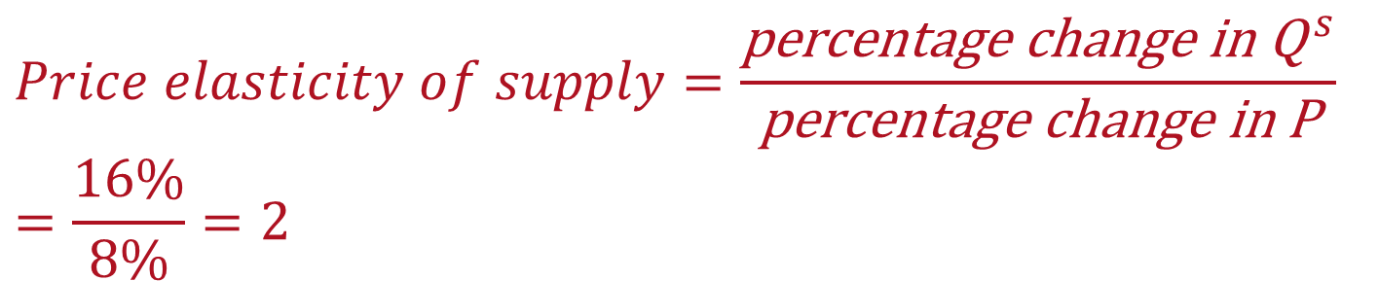
Calculating Price Elasticity of Supply
0
Again, we use the midpoint method to compute the percentage changes.
$$Price elasticity of supply=\frac{\text{percentage} \text{change} \text{in} {\text{Q}}^{ s}}{\text{percentage} \text{change} \text{in} \text{P}}=\frac{16\%}{8\%}=2$$
P
S
P rises by 8%
P₂
P₁
Q
Q₁
Q₂
Q rises by 16%
Notes:
39

Slide 40
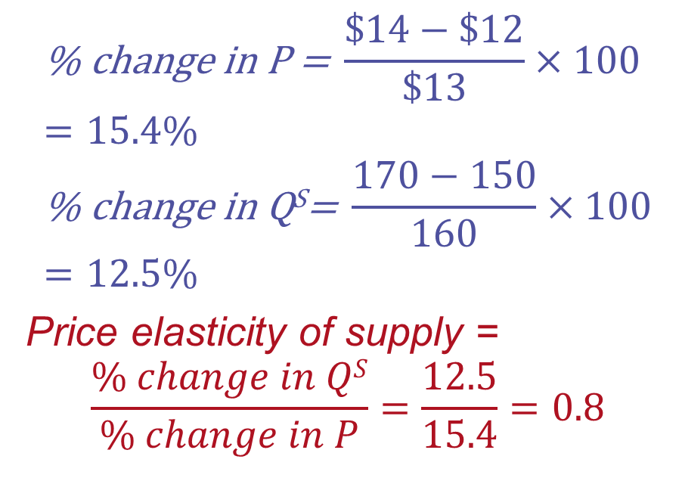
EXAMPLE 5: Price elasticity of supply
The price of pizza increased from $12 to $14 per pie, and increased the quantity produces in your town from 150 to 170 pies per day.
$$\text{\% }\text{change} \text{in} \text{P}\text{ = }\frac{\$14−\$12}{\$13}×100=15.4\% \\ \text{\% }\text{change} \text{in} \text{QS}\text{= }\frac{170−150}{160}×100=12.5\%$$
Price elasticity of supply =
$$\frac{\% change in QS}{\% change in P}=\frac{12.5}{15.4}=0.8$$
P
S
$14
$12
150
170
Q
Notes:
Again, we are using the midpoint formula to calculate the percentage change in our variables.
Percentage change in price = 100 * (difference )/ midpoint.

Slide 41
The Variety of Supply Curves – 1
Supply is unit elastic
Price elasticity of supply = 1
Supply is elastic
Price elasticity of supply > 1
Supply is inelastic
Price elasticity of supply < 1

Slide 42
The Variety of Supply Curves – 2
Supply is perfectly inelastic
Price elasticity of supply = 0
Supply curve is vertical
Supply is perfectly elastic
Price elasticity of supply = infinity
Supply curve is horizontal
The flatter the supply curve
The greater the price elasticity of supply
Notes:
Economists classify supply curves according to their elasticity.
The next five slides present the different classifications, from least to most elastic.

Slide 43
Perfectly Inelastic Supply
0
Price elasticity of supply
% change in Q
0%
=
=
= 0
% change in P
10%
S curve:
vertical
Sellers’ price sensitivity:
none
Elasticity:
0
P
S
P₂
P rises by 10%
P₁
Q
Q₁
Q changes by 0%
Notes:
43

Slide 44
Inelastic Supply
0
Price elasticity of supply
% change in Q
< 10%
=
=
< 1
% change in P
10%
S curve:
relatively steep
Sellers’ price sensitivity:
relatively low
Elasticity:
< 1
P
S
P₂
P rises by 10%
P₁
Q
Q₁
Q₂
Q rises less than 10%
Notes:
44

Slide 45
Unit Elastic Supply
0
Price elasticity of supply
% change in Q
10%
=
=
= 1
% change in P
10%
S curve:
intermediate slope
Sellers’ price sensitivity:
intermediate
Elasticity:
= 1
P
S
P₂
P₁
P rises by 10%
Q
Q₁
Q₂
Q rises by 10%
Notes:
45

Slide 46
Elastic Supply
0
Price elasticity of supply
% change in Q
> 10%
=
=
> 1
% change in P
10%
S curve:
relatively flat
Sellers’ price sensitivity:
relatively high
Elasticity:
> 1
P
S
P rises by 10%
P₂
P₁
Q
Q₁
Q₂
Q rises more than 10%
Notes:
46

Slide 47
Perfectly Elastic Supply
0
Price elasticity of supply
% change in Q
any %
=
=
= infinity
% change in P
0%
S curve:
horizontal
Sellers’ price sensitivity:
extreme
Elasticity:
infinity
P
P₂ =
P₁
S
P changes by 0%
Q
Q₁
Q₂
Q changes by any %
Notes:
47

Slide 48
The Determinants of Supply Elasticity
Greater price elasticity of supply
The more easily sellers can change the quantity they produce
Price elasticity of supply is greater in the long run than in the short run
In the long run: firms can build new factories, or new firms may be able to enter the market
Notes:
This section is not perfectly analogous to the section on the determinants of the price elasticity of demand, but it’s similar enough that you can probably cover it more quickly and with much less hand-holding.
For example, the supply of beachfront property is harder to vary and thus less elastic than supply of new cars.

Slide 49
Active Learning 3: Elasticity and changes in equilibrium
Assume the supply of parking spots is inelastic and the supply of wheat is elastic. Suppose population growth causes demand for both goods to double (at each price, Q^{d} doubles).
For which product will P change the most?
For which product will Q change the most?
Draw a graph with the new equilibrium in the market for parking
Draw a graph with the new equilibrium in the market for wheat
Notes:
Note that “at each price Q^{d} doubles” is not a parallel shift of the demand curve: the D curve shifts outward and becomes less steep.

Slide 50
Active Learning 3A: Parking spots
Parking spots (inelastic supply):
When supply is inelastic, an increase in demand has a bigger impact on price than on quantity.
P
S
D₁
D₂
P₂
B
A
P₁
Q
Q₁
Q₂
Notes:
In this slide and the next, the initial price and quantity and the two demand curves are the same. The only difference is the elasticity of supply and slope of the supply curve.
[The D curve shifts to the right, but not in a parallel fashion: at each price, quantity demanded is twice as high, so the new D curve will be flatter than the initial one.]
In the text box containing the verbal explanation, “bigger impact” is shorthand for “bigger percentage impact” or “bigger proportional impact.”

Slide 51
Active Learning 3B: Wheat
Wheat
(elastic supply):
When supply is elastic, an increase in demand has a bigger impact on quantity than on price.
P
D₁
D₂
B
S
P₂
A
P₁
Q
Q₁
Q₂

Slide 52
How the Price Elasticity of Supply can Vary
Price
Elasticity is small
(less than 1).
Supply
$15
12
Elasticity is large
(greater than 1).
4
3
0
100
200
500
525
Quantity
Supply often becomes less elastic as Q rises, due to capacity limits.
Notes:
This is Figure 6 from the textbook.
When the price rises from $3 to $4 (a 29% increase, using the midpoint method), quantity rises from 100 to 120 (or 67%). Because 67% > 29%, price elasticity of supply is greater than one.
When the price rises from $12 to $15 (22%), quantity rises from 500 to 525 (about 5%), so price elasticity of supply is less than one.
When output is very low, it is relatively easy for firms to increase output: they may have excess capacity, or they are not requiring full effort from their workers. Increasing output is not difficult, so it doesn’t take much of an increase in price to induce an increase in production.
When output is very high, it is relatively expensive for firms to increase output further: there’s little or no excess capacity, they are already running their factories and machines at a high level of intensity. To increase output further, they might have to pay their workers overtime, and their machines experience more wear and tear and therefore require more repairs. So, at high levels of output, it takes a much larger price increase to make firms willing to increase output further.
Eventually, firms bump up against their capacity constraints, and simply cannot increase output in response to further price increases.
Of course, all of this applies to the short run. In the long run, firms can build more factories, and (depending on the market structure) new firms can enter the market.
Real-world example: In the peak summer driving season, gasoline demand is highest. Many refineries are producing near capacity, so the supply curve is steep. In other months, when demand is lower, refineries have more excess capacity, and the supply curve is not as steep.

Slide 53
More Applications – 1
1. Can Good News for Farming Be Bad News for Farmers?
New hybrid of wheat: 20% increased production per acre
Supply curve shifts to the right
Higher quantity and lower price
Demand is inelastic: total revenue falls
Paradox of public policy: induce farmers not to plant crops
Notes:
We already discussed one of the three applications in the textbook (Does Drug Interdiction Increase or Decrease Drug-related Crime?)
Two more are presented in this and the next few slides.

Slide 54
A Supply Increase in the Market for Wheat
1. When demand is inelastic,
an increase in supply . . .
Price of
Wheat
S₁
S₂
2. … leads
to a large fall in price. . .
$3
3. … and a proportionately smaller increase in quantity sold. As a result, revenue falls from $300 to $220.
2
Demand
0
100
110
Quantity of Wheat
Notes:
This is Figure 7 from the text.
When an advance in farm technology increases the supply of wheat from S₁ to S₂, the price of wheat falls. Because the demand for wheat is inelastic, the increase in the quantity sold from 100 to 110 is proportionately smaller than the decrease in the price from $3 to $2. As a result, farmers’ total revenue falls from $300 ($3 × 100) to $220 ($2 × 110).
If time allows, you should discuss the changes in farming and the public policy paradox. (The students can read these in the textbook)
Major change in the U.S. economy over the past century:
200 years ago, most Americans lived on farms.
Over time, advances in farm technology increased the amount of food that each farmer could produce. This increase in food supply, together with the inelastic demand for food, caused farm revenues to fall, which in turn encouraged people to leave farming.
In 1900, 12 million people worked on farms (40% of the labor force).
In 2020, 3 million people worked on farms (2% of labor force)
This change coincided with great advances in farm productivity. Despite the large drop in the number of farmers, U.S. farms fed a population that increased more than fourfold, thanks to rising productivity.
Paradox of public policy: Certain farm programs try to help farmers by inducing them not to plant crops. Why? To reduce the supply of farm products and thereby raise prices. With inelastic demand for their products, farmers as a group receive greater total revenue if they supply a smaller crop to the market. No single farmer would choose to leave her land fallow on her own because each takes the market price as given. But if all farmers do so together, they can all be better off.
What is good for farmers is not necessarily good for society as a whole.
Improvement in farm technology: can be bad for farmers because it makes farmers increasingly unnecessary, but it is surely good for consumers who pay less for food.
A policy aimed at reducing the supply of farm products may raise the incomes of farmers, but it does so at the expense of consumers.

Slide 55
More Applications – 2
2. Why Has OPEC Failed to Keep the Price of Oil High?
Increase in prices 1973-1974, 1979-1981
Short-run: supply and demand are inelastic
Decrease in supply: large increase in price
Long-run: supply and demand are elastic
Decrease in supply: small increase in price
Notes:
In the short-run: S and D curves are very steep.
In the long run: producers respond to high prices by increasing oil exploration and by building new extraction capacity. Consumers respond with greater conservation, such as by replacing old inefficient cars with newer efficient ones.

Slide 56
A Reduction in Supply in the World Market for Oil
(a) The Oil Market in the Short Run
(b) The Oil Market in the Long Run
1. In the short run, when supply and demand are inelastic, a shift in supply. . .
1. In the long run, when supply and demand are elastic, a shift in supply. . .
Price
Price
S₂
2. … leads to a small increase in price
S₁
S₂
S₁
P₂
P₂
P₁
P₁
2. … leads to a large increase in price
Demand
Demand
0
Quantity
0
Quantity
Notes:
This is Figure 8 from the textbook.
When the supply of oil falls, the response depends on the time horizon. In the short run, supply and demand are relatively inelastic, as in panel (a). Thus, when the supply curve shifts from S₁ to S₂, the price rises substantially.
In the long run, however, supply and demand are relatively elastic, as in panel (b). In this case, the same size shift in the supply curve (S₁ to S₂) causes a smaller increase in the price.

Slide 57
THINK-PAIR-SHARE
In order to reduce teen smoking, the government places a $2 per pack tax on cigarettes. After one month, the quantity demanded of ciga­rettes has been reduced only slightly. Discuss the following:
What conclusion can you draw about the one-month demand for cigarettes?
Caleb suggests that the cigarette industry should get together and raise the price of cigarettes further to increase total revenue .
Keisha suggests that only your firm should raise the price of your cigarettes to increase total revenue.
Mankiw, Principles of Economics, 11th Edition. © 2027 Cengage. All Rights Reserved. May not be scanned, copied or duplicated, or posted to a publicly accessible website, in whole or in part.
Notes:
Suggestion: For the Think-Pair-Share activities, if time allows, allow students to work in small groups for 5-10 minutes. Then allow student groups to share with other groups or with the entire class. Or, you can treat the Think-Pair-Share activity as an open-to-all in-class discussion.
Discussion points: Assume that you, Caleb and Keisha work for the same cigarettes producing firm.
A. A $2 tax per pack is a big increase in price (the price of cigarettes varies between $5 and $12 (NY) per pack, so the $2 tax can be between 16% and 40% increase in price). And the problem specifies that the quantity demanded has declined slightly in one month. So, the one-month demand for cigarettes is inelastic.
B. The entire cigarettes industry increasing prices may not lead to higher revenue for the industry. Demand tends to be more elas­tic over longer periods. In the case of cigarettes, some consumers will substitute toward cigars and pipes. Others may quit or never start to smoke.
C. The total revenue for your firm will decrease. While the demand for cigarettes (the market broadly defined) may be inelastic, the demand for any one brand (market narrowly defined) is likely to be much more elastic because consum­ers can substitute toward other lower priced brands.

Slide 58
CHAPTER IN A NUTSHELL
The price elasticity of demand
Measures how much the quantity demanded responds to price changes.
Is the percentage change in quantity demanded divided by the percentage change in price.
If < 1, inelastic demand: quantity demanded moves proportionately less than the price
If > 1, elastic demand: quantity demanded moves proportionately more than the price

Slide 59
CHAPTER IN A NUTSHELL
Demand tends to be more elastic if
Close substitutes are available
The good is a luxury rather than a necessity
The market is narrowly defined
If buyers have substantial time to react to a price change.
Total revenue (P × Q), total amount paid for a good
Moves in the same direction as P (inelastic D)
Moves in the opposite direction as P (elastic D)

Slide 60
CHAPTER IN A NUTSHELL
The income elasticity of demand
Measures how much the quantity demanded responds to changes in consumers’ income
The cross-price elasticity of demand
Measures how much the quantity demanded of one good responds to changes in the price of another
The tools of supply and demand can be applied to many different kinds of markets (in this chapter: the market for wheat, the market for oil, and the market for illegal drugs)

Slide 61
CHAPTER IN A NUTSHELL
The price elasticity of supply
Measures how much the quantity supplied responds to changes in the price.
Is the percentage change in quantity supplied divided by the percentage change in price
If < 1, inelastic supply: quantity supplied moves proportionately less than the price
If > 1, elastic supply: quantity supplied moves proportionately more than the price
Depends on the time horizon under consideration. In most markets, supply is more elastic in the long run than in the short run.

